Slide 1
L3 (CHAPTER 6) Programming in Assembly Part 2: Data Manipulation Exercises ANS

Slide 2
Load Instructions
Review
LDR rt, [rs]
fetch data from memory into register rt.
The memory address is specified in register rs.
For Example:
; Assume r0 = 0x08200004
; Load a word:
LDR r1, [r0] ; r1 = Memory.word[0x08200004]

Slide 3
Store Instructions
Review
STR rt, [rs]:
save data in register rt into memory
The memory address is specified in a base register rs.
For Example:
; Assume r0 = 0x08200004
; Store a word
STR r1, [r0] ; Memory.word[0x08200004] = r1

Slide 4
Question: Load-Modify-Store
C statement
x = x + 1;
; Assume the memory address of x is stored in r1. Write the assembler program for the C statement.
Notes:
Assume x is a 32-bit integer stored in the memory

Slide 5
Answer: Load-Modify-Store
C statement
x = x + 1;
; Assume the memory address of x is stored in r1. Write the assembler program for the C statement.
LDR r0, [r1] ; load value of x from memory
ADD r0, r0, #1 ; x = x + 1
STR r0, [r1] ; store x into memory
Notes:
Assume x is a 32-bit integer stored in the memory

Slide 6
Loading Constants: LDR
Review
LDR r_{d},=constant
A special “pseudo-operation” that will work for any constant up to 32 bits wide.
You simply write what appears to be a regular ARM instruction (except that an equal sign is substituted for the pound sign) and let the assembler sort out the most efficient way to achieve your objective:
Converted to MOV or MVN if possible
Else converts to LDR r_{d},[pc,#imm]
Examples:
LDR R1,=10 ;assembler replaces this by MOV R1,#10.
LDR R1,=−15 ;assembler replaces this by MVN R1,#14.
LDR R1,=−127435 ;assembler replaces this by a memory reference instruction that loads the constant −127435 from a separate memory location.

Slide 7
LDRH (Load Halfword)
Review
15 | 0
16-bit Memory Half-Word (unmodified)
0 0 | 0 0
. . . . . . . . . .
. . . . . . . . . .
32-bit Register
31 |  |  | 16 | 15 |  |  | 0
When loading 8- or 16-bit data into a 32-bit register, the operand itself is always right justified within the register and its most significant bits filled according to whether the value is signed or unsigned. Unsigned operands less than 32 bits wide must fill the extra bit positions with zeroes (called “zero-filling”).
Notes:
when loading 8- or 16-bit data into a 32-bit register, the operand itself is always right
justified within the register and its most significant bits filled according to whether the
value is signed or unsigned

Slide 8
LDRSH (Load Signed Halfword)
Review
15 | 0
16-bit Memory Half-Word (unmodified)
. . . . . . . . . .
. . . . . . . . . .
32-bit Register
31 |  |  | 16 | 15 |  |  | 0
Signed operands less than 32 bits wide must fill the extra bit positions with copies of their sign bit

Slide 9
Load (from memory) Instructions
Review
Load/Store Memory | Operation | Notes
LDR r_{d},<mem> | r_{d} ← mem₃₂[address]
LDRB r_{d},<mem> | r_{d} ← mem₈[address] | Zero fills
LDRH r_{d},<mem> | r_{d} ← mem₁₆[address] | Zero fills
LDRSB r_{d},<mem> | r_{d} ← mem₈[address] | Sign extends
LDRSH r_{d},<mem> | r_{d} ← mem₁₆[address] | Sign extends
LDRD r_{t},r_{t2},<mem> | r_{t2}. r_{t} ← mem₆₄[address]
Notes:
These instructions never affect flags in xPSR!

Slide 10
STRH (Store Halfword)
Review
31 |  |  | 16 | 15 |  |  | 0
32-bit Register (unmodified)
Most-significant 16 bits are not written into memory
. . . . . . . . . .
16-bit Memory Half-Word
15 | 0
Writing a half-word result to address 104: The two memory bytes that should be written are at addresses 104 and 105. However, the 32-bit memory data bus is actually 4 bytes wide, corresponding to addresses 104, 105, 106, and 107. Each byte of the memory data bus has its own write enable; during the memory write cycle, the write-enable signals for addresses 106 and 107 are disabled so that only the bytes at addresses 104 and 105 are modified.

Slide 11
Store (to memory) Instructions
Review
Load/Store Memory | Operation | Memory Byte Addresses Actually Written
STR r_{d},<mem> | r_{d} → mem₃₂[addr] | addr+3 | addr+2 | addr+1 | addr
STRB r_{d},<mem> | r_{d} → mem₈[addr] |  |  |  | addr
STRH r_{d},<mem> | r_{d} → mem₁₆[addr] |  |  | addr+1 | addr
STRD r_{t}, r_{t2},<mem> | r_{t2}.r_{t} → mem₆₄[addr]
Notes:
These instructions never affect flags in xPSR!

Slide 12
LDR and STR
Review
LDR | Load Word
LDRB | Load Byte
LDRH | Load Halfword
LDRSB | Load Signed Byte
LDRSH | Load Signed Halfword
STR | Store Word
STRB | Store Lower Byte
STRH | Store Lower Halfword
Notes:
Point out destination (reg) first for LDR, but destination (mem) last for STR. Different to Motorola, but it keeps the instruction mnemonic format consistent. Always have register loaded/stored first, then address accessed second
Size specifier comes out on MAS (memory access size) signal. Important that memory supports full range of accesses - especially important for writes where only the specified size should be written.
Special types of sign extended load - this is needed because ARM registers only hold 32-bit values. Draw diagram. No need for special store instructions though.
Instruction cycle timing:
STR LDR
7TDMI 2 cycles 3 cycles
9TDMI 1 cycle 1 cycle - interlock if used in next cycle
StrongARM1 1 cycle 1 cycle - interlock if used in next cycle
Xscale 1 cycle 1 cycle - interlock if used in next 2 cycles
Note size specifier comes after condition code.
Link: <address> explained on next slide.
Note that load/store instructions never set condition codes.

Slide 13
Assume Little-Endianness
For the rest of the questions, assume Little-Endian ordering by default unless specified otherwise

Slide 14
Question: Load a Byte, Half-word, Word
What does r1 contain: Load a Byte
LDRB r1, [r0]
r1
0x02000003
0x87
0x02000002
0x65
31
0
0xE3
0x02000001
0x02000000
0xE1
What does r1 contain: Load a Halfword
LDRH r1, [r0]
Little Endian
r1
31
0
Assume
r0 = 0x02000000
What does r1 contain: Load a Word
LDR r1, [r0]
r1
31
0
Use zero-filling for remaining Bytes

Slide 15
Answer: Load a Byte, Half-word, Word
What does r1 contain: Load a Byte
LDRB r1, [r0]
r1
0x00
0x00
0x00
0xE1
0x02000003
0x87
0x02000002
0x65
31
0
0xE3
0x02000001
0x02000000
0xE1
What does r1 contain: Load a Halfword
LDRH r1, [r0]
Little Endian
r1
0x00
0x00
0xE3
0xE1
31
0
Assume
r0 = 0x02000000
What does r1 contain: Load a Word
LDR r1, [r0]
r1
0x87
0x65
0xE3
0xE1
31
0

Slide 16
Question: Sign Extension
Load a Signed Byte. Sign-bit of 0xE1（11100001） is its leftmost bit (1),
so the left 3 Bytes of r1 are filled with all 1’s
LDRSB r1, [r0]
r1
0x20000003
0x87
0x20000002
0x65
31
0
0xE3
0x20000001
Load a Signed Halfword. Sign-bit of 0xE3E1
(1110001111100001） is its leftmost bit (1),so the left 3
Bytes of r1 are filled with all 1’s
0x20000000
0xE1
Little Endian
LDRSH r1, [r0]
r1
Assume
r0 = 0x02000000
31
0
Use sign-filling for remaining Bytes
Facilitate subsequent 32-bit signed arithmetic!

Slide 17
Answer: Sign Extension
Load a Signed Byte. Sign-bit of 0xE1（11100001） is its leftmost bit (1),
so the left 3 Bytes of r1 are filled with all 1’s
LDRSB r1, [r0]
r1
0xFF
0xFF
0xFF
0xE1
0x20000003
0x87
0x20000002
0x65
31
0
0xE3
0x20000001
Load a Signed Halfword. Sign-bit of 0xE3E1
(1110001111100001） is its leftmost bit (1),so the left 3
Bytes of r1 are filled with all 1’s
0x20000000
0xE1
Little Endian
LDRSH r1, [r0]
r1
0xFF
0xFF
0xE3
0xE1
Assume
r0 = 0x02000000
31
0
Use sign-filling for remaining Bytes
Facilitate subsequent 32-bit signed arithmetic!

Slide 18
Address
Review
Address accessed by LDR/STR is specified by a base register plus an offset
For word and unsigned byte accesses, offset can be
An unsigned 12-bit immediate value (i.e. 0 - 4095 bytes). LDR r0,[r1,#8]
A register, optionally shifted by an immediate value LDR r0,[r1,r2] LDR r0,[r1,r2,LSL#2]
This can be either added or subtracted from the base register: LDR r0,[r1,#-8] LDR r0,[r1,-r2] LDR r0,[r1,-r2,LSL#2]
For halfword and signed halfword / byte, offset can be:
An unsigned 8 bit immediate value (i.e. 0-255 bytes).
A register (unshifted).
Choice of pre-indexed or post-indexed addressing
Notes:
Halfword access and signed halfword/byte accesses were added to the architecture in v4T, this is the reason the offset field is not as flexible as the normal word/byte load/store - not a problem because these accesses are less common.
Link: diagram on next slide

Slide 19
Addressing Modes
Review
Offset addressing (most important):
LDR R1,[R0] ;Load R1 from memory address R0
LDR R1,[R0,#16] ;Load R1 from memory address R0+16
Auto-indexing with pre-indexed addressing mode:
LDR R1,[R0,#16]! ;Load from memory address R0+16, then ;update R0 = R0+16
Auto-indexing with post-indexed addressing mode:
LDR R1,[R0],#16 ;Load R0 from memory address R0, then
;update R0 = R0+16
Notes:
Program counter (PC)-relative addressing mode:
LDR R0, [R15, #24] ;loads R0 with the word pointed at by PC+24

Slide 20
Addressing Modes
Review
Index Format | Example | Equivalent
offset | LDR r1, [r0, #4] | r1 ← memory[r0 + 4], r0 is unchanged
Pre-index | LDR r1, [r0, #4]! | r1 ← memory[r0 + 4] r0 ← r0 + 4
Post-index | LDR r1, [r0], #4 | r1 ← memory[r0] r0 ← r0 + 4
Offset range is -255 to +255
Notes:
Halfword access and signed halfword/byte accesses were added to the architecture in v4T, this is the reason the offset field is not as flexible as the normal word/byte load/store - not a problem because these accesses are less common.
Link: diagram on next slide

Slide 21
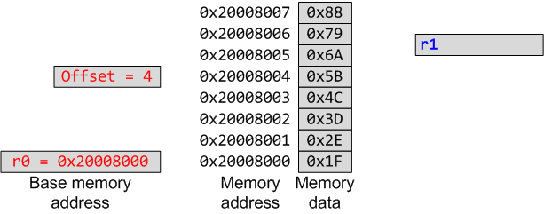
Question: LDR w/ Offset
What do r0 and r1 contain after: LDR r1, [r0, #4]
Offset range is -255 to +255

Slide 22
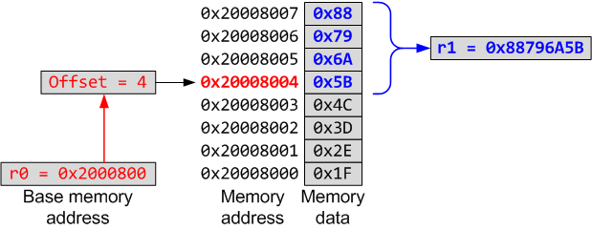
Answer: LDR w/ Offset
What do r0 and r1 contain after: LDR r1, [r0, #4]
r0 stays unchanged (0x2000800); r1 gets assigned 4 Bytes at
address 0x2000800，which is 0x88796A5B
Offset range is -255 to +255
Notes:
“!” indicates “writeback” i.e. the base register is to be updated after the instruction.
No “!” for post-indexed because post-increment of base register always happens (otherwise the offset field would not be used at all).
Give C example:
int *ptr;
x = *ptr++;
Compiles to a single instruction:
LDR r0, [r1], #4

Slide 23
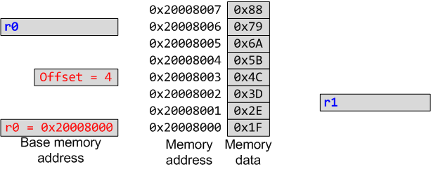
Question: LDR w/ Post-index
What do r0 and r1 contain after: LDR r1, [r0], #4
Offset range is -255 to +255
Notes:
“!” indicates “writeback” i.e. the base register is to be updated after the instruction.
No “!” for post-indexed because post-increment of base register always happens (otherwise the offset field would not be used at all).
Give C example:
int *ptr;
x = *ptr++;
Compiles to a single instruction:
LDR r0, [r1], #4

Slide 24
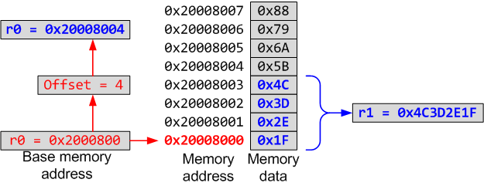
Answer: LDR w/ Post-index
What do r0 and r1 contain after: LDR r1, [r0], #4
r0 is incremented by 4 (0x2000804), AFTER r1 gets assigned
4 Bytes at address old r0=0x2000800，which is 0x4C3D2E1F
Offset range is -255 to +255
Notes:
“!” indicates “writeback” i.e. the base register is to be updated after the instruction.
No “!” for post-indexed because post-increment of base register always happens (otherwise the offset field would not be used at all).
Give C example:
int *ptr;
x = *ptr++;
Compiles to a single instruction:
LDR r0, [r1], #4

Slide 25
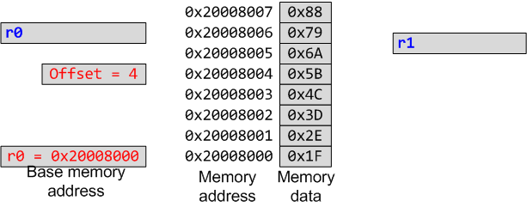
Question: LDR w/ Pre-index
What do r0 and r1 contain after: LDR r1, [r0, #4]!
Offset range is -255 to +255
Notes:
“!” indicates “writeback” i.e. the base register is to be updated after the instruction.
No “!” for post-indexed because post-increment of base register always happens (otherwise the offset field would not be used at all).
Give C example:
int *ptr;
x = *ptr++;
Compiles to a single instruction:
LDR r0, [r1], #4

Slide 26
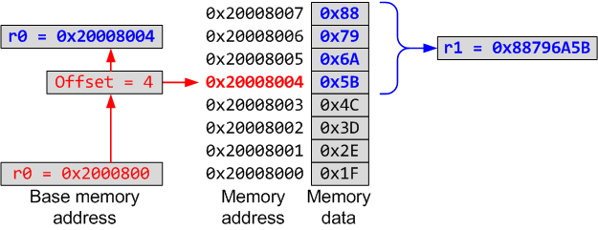
Answer: LDR w/ Pre-index
What do r0 and r1 contain after: LDR r1, [r0, #4]!
r0 is incremented by 4 (0x2000804), BEFORE r1 gets assigned
4 Bytes at address new r0=0x2000804，which is 0x88796A5B
Offset range is -255 to +255
Notes:
“!” indicates “writeback” i.e. the base register is to be updated after the instruction.
No “!” for post-indexed because post-increment of base register always happens (otherwise the offset field would not be used at all).
Give C example:
int *ptr;
x = *ptr++;
Compiles to a single instruction:
LDR r0, [r1], #4

Slide 27
Question: LDRH
LDRH r1, [r0]
; r0 = 0x20008000
Memory Address | Memory Data
0x20008003 | 0x89
0x20008002 | 0xAB
0x20008001 | 0xCD
0x20008000 | 0xEF
r1 before load
0x12345678
r1 after load
?
Notes:
Halfword access and signed halfword/byte accesses were added to the architecture in v4T, this is the reason the offset field is not as flexible as the normal word/byte load/store - not a problem because these accesses are less common.
Link: diagram on next slide

Slide 28
Answer: LDRH
LDRH r1, [r0]
; r0 = 0x20008000
LDRH (Load Half-Word) loads 2 Bytes at address r0, 0xCDEF,
Fills the higher 2 Bytes with 0 to get r1=0x0000CDEF
Memory Address | Memory Data
0x20008003 | 0x89
0x20008002 | 0xAB
0x20008001 | 0xCD
0x20008000 | 0xEF
r1 before load
0x12345678
r1 after load
0x0000CDEF
Notes:
Halfword access and signed halfword/byte accesses were added to the architecture in v4T, this is the reason the offset field is not as flexible as the normal word/byte load/store - not a problem because these accesses are less common.
Link: diagram on next slide

Slide 29
Question: LDSB
What is r1 after: LDSB r1, [r0]
; r0 = 0x20008000
Memory Address | Memory Data
0x20008003 | 0x89
0x20008002 | 0xAB
0x20008001 | 0xCD
0x20008000 | 0xEF
r1 before load
0x12345678
r1 after load
?
Notes:
Halfword access and signed halfword/byte accesses were added to the architecture in v4T, this is the reason the offset field is not as flexible as the normal word/byte load/store - not a problem because these accesses are less common.
Link: diagram on next slide

Slide 30
Answer: LDSB
What is r1 after: LDSB r1, [r0]
; r0 = 0x20008000
LDSB (Load Signed Byte) loads 1 Byte at address r0, 0xEF
Which is 11101111 with sign bit 1; fill the higher 3 Bytes
with all 1’s to get 0xFFFFFFEF
Memory Address | Memory Data
0x20008003 | 0x89
0x20008002 | 0xAB
0x20008001 | 0xCD
0x20008000 | 0xEF
r1 before load
0x12345678
r1 after load
0xFFFFFFEF
Notes:
Halfword access and signed halfword/byte accesses were added to the architecture in v4T, this is the reason the offset field is not as flexible as the normal word/byte load/store - not a problem because these accesses are less common.
Link: diagram on next slide

Slide 31
Question: STR w/ Post-Index
What are r0, and memory content after: STR r1, [r0], #4
; r0 = 0x20008000, r1=0x76543210
Memory Address | Memory Data
0x20008007 | 0x00
0x20008006 | 0x00
0x20008005 | 0x00
0x20008004 | 0x00
0x20008003 | 0x00
0x20008002 | 0x00
0x20008001 | 0x00
0x20008000 | 0x00
r0 before store
0x20008000
r0 after store
Notes:
Halfword access and signed halfword/byte accesses were added to the architecture in v4T, this is the reason the offset field is not as flexible as the normal word/byte load/store - not a problem because these accesses are less common.
Link: diagram on next slide

Slide 32
Answer: STR w/ Post-Index
What are r0, and memory content after: STR r1, [r0], #4
; r0 = 0x20008000, r1=0x76543210
r0 is incremented by 4 (0x2000804), AFTER r1 is stored
to address old r0=0x2000800
Memory Address | Memory Data
0x20008007 | 0x00
0x20008006 | 0x00
0x20008005 | 0x00
0x20008004 | 0x00
0x20008003 | 0x76
0x20008002 | 0x54
0x20008001 | 0x32
0x20008000 | 0x10
r0 before store
0x20008000
r0 after store
0x20008004
Notes:
Halfword access and signed halfword/byte accesses were added to the architecture in v4T, this is the reason the offset field is not as flexible as the normal word/byte load/store - not a problem because these accesses are less common.
Link: diagram on next slide

Slide 33
Question: STR with Offset
What are r0, and memory content after: STR r1, [r0, #4]
; r0 = 0x20008000, r1=0x76543210
Memory Address | Memory Data
0x20008007 | 0x00
0x20008006 | 0x00
0x20008005 | 0x00
0x20008004 | 0x00
0x20008003 | 0x00
0x20008002 | 0x00
0x20008001 | 0x00
0x20008000 | 0x00
r0 before the store
0x20008000
r0 after the store
Notes:
Halfword access and signed halfword/byte accesses were added to the architecture in v4T, this is the reason the offset field is not as flexible as the normal word/byte load/store - not a problem because these accesses are less common.
Link: diagram on next slide

Slide 34
Answer: STR with Offset
What are r0, and memory content after: STR r1, [r0, #4]
; r0 = 0x20008000, r1=0x76543210
r0 stays unchanged (0x2000800). r1 is stored
to address r0+4=0x2000804，so [r0+4]=0x76543210
Memory Address | Memory Data
0x20008007 | 0x76
0x20008006 | 0x54
0x20008005 | 0x32
0x20008004 | 0x10
0x20008003 | 0x00
0x20008002 | 0x00
0x20008001 | 0x00
0x20008000 | 0x00
r0 before store
0x20008000
r0 after store
0x20008000
Notes:
Halfword access and signed halfword/byte accesses were added to the architecture in v4T, this is the reason the offset field is not as flexible as the normal word/byte load/store - not a problem because these accesses are less common.
Link: diagram on next slide

Slide 35
Question: STR with Pre-Index
What are r0, and memory content after: STR r1, [r0, #4]!
; r0 = 0x20008000, r1=0x76543210
Memory Address | Memory Data
0x20008007 | 0x00
0x20008006 | 0x00
0x20008005 | 0x00
0x20008004 | 0x00
0x20008003 | 0x00
0x20008002 | 0x00
0x20008001 | 0x00
0x20008000 | 0x00
r0 before store
0x20008000
r0 after store
Notes:
Halfword access and signed halfword/byte accesses were added to the architecture in v4T, this is the reason the offset field is not as flexible as the normal word/byte load/store - not a problem because these accesses are less common.
Link: diagram on next slide

Slide 36
Answer: STR with Pre-Index
What are r0, and memory content after: STR r1, [r0, #4]!
; r0 = 0x20008000, r1=0x76543210
r0 is incremented by 4 (0x2000804), BEFORE r1 is stored
to address new r0=0x2000804，so [r0+4]=0x76543210
Memory Address | Memory Data
0x20008007 | 0x76
0x20008006 | 0x54
0x20008005 | 0x32
0x20008004 | 0x10
0x20008003 | 0x00
0x20008002 | 0x00
0x20008001 | 0x00
0x20008000 | 0x00
r0 before store
0x20008000
r0 after store
0x20008004
Notes:
Halfword access and signed halfword/byte accesses were added to the architecture in v4T, this is the reason the offset field is not as flexible as the normal word/byte load/store - not a problem because these accesses are less common.
Link: diagram on next slide

Slide 37
Question: LDR w/ Big Endian Ordering
What is r11 after load with Big-Endian ordering?
LDR r11, [r0]
; r0 = 0x20008000
Memory Address | Memory Data
0x20008003 | 0xEE
0x20008002 | 0x8C
0x20008001 | 0x90
0x20008000 | 0xA7
r11 before load
0x12345678
r11 after load
?
Notes:
Halfword access and signed halfword/byte accesses were added to the architecture in v4T, this is the reason the offset field is not as flexible as the normal word/byte load/store - not a problem because these accesses are less common.
Link: diagram on next slide

Slide 38
Answer: LDR w/ Big Endian Ordering
What is r11 after load with Big-Endian ordering?
LDR r11, [r0]
; r0 = 0x20008000
Memory Address | Memory Data
0x20008003 | 0xEE
0x20008002 | 0x8C
0x20008001 | 0x90
0x20008000 | 0xA7
r11 before load
0x12345678
r11 after load
0xA7908CEE
Notes:
Halfword access and signed halfword/byte accesses were added to the architecture in v4T, this is the reason the offset field is not as flexible as the normal word/byte load/store - not a problem because these accesses are less common.
Link: diagram on next slide

Slide 39
ARM ADR Pseudo-op
Review
ADR pseudo-op generates instruction required to calculate address:
ADR R1,x ;get memory address of variable x and put it in register R1
Notes:
Generate value by performing arithmetic on PC. Cannot refer to an address directly in an instruction.

Slide 40
Example 1: Assignment
Review
C:
//assume x, a, b are 32-bit integer variables
x = a - b;
Assembler:
ADR R4,a ; get address for a
LDR R0,[R4] ; get value of a
ADR R4,b ; get address for b, reusing R4
LDR R1,[R4] ; get value of b
SUB R0,R0,R1 ; subtract R1 from R0, and store result in R0
ADR R4,x ; get address for x
STR R0,[R4] ; store value of x into memory
Notes:
label1 ADR R4,c ; take memory address of variable c and put it ; into register R4
LDR R0,[R4] ; load content at memory address R4 into register ; R0
ADR R4,d
LDR R1,[R4]
SUB R0,R0,R1 ; subtract R1 from R0, and store result in R0 ; (R0 -= R1)

Slide 41
Question: Programming
Q: Fill in the blanks of the following assembly program that implements the following C program snippet (assuming x, y and z are 32-bit ints):
//C Program
//assume x, y, z, are integer variables
z=x+y;
z=z²
%Assembler Program
ADR R4, x
...
ADR R4, y
...
ADR R4, z
...

Slide 42
Answer: Programming
Q: Fill in the blanks of the following assembly program that implements the following C program snippet (assuming x, y and z are 32-bit ints):
//C Program
//assume x, y, z, are integer variables
z=x+y;
z=z²
%Assembler Program
ADR R4, x
LDR R0, [R4]
ADR R4, y
LDR R1, [R4]
ADD R2, R0, R1
MUL R3, R2, R2
ADR R4, z
STR R3, [R4]
Q: can you reduce the number of
Registers used in this program?

Slide 43
Question: Programming
Q: can you reduce the number of registers used in the assembler program?
//C Program
//assume x, y, z, are integer variables
z=x+y;
z=z²
%Assembler Program
ADR R4, x
LDR R0, [R4]
ADR R4, y
LDR R1, [R4]
ADD R2, R0, R1
MUL R3, R2, R2
ADR R4, z
STR R3, [R4]

Slide 44
Answer: Programming
Q: can you reduce the number of registers used in the assembler program?
//C Program
//assume x, y, z, are integer variables
z=x+y;
z=z²
Answer: yes
%Assembler Program
ADR R4, x
LDR R0, [R4]
ADR R4, y
LDR R1, [R4]
ADD R2, R0, R1
MUL R3, R2, R2
ADR R4, z
STR R3, [R4]
%Assembler Program v2
ADR R4, x
LDR R0, [R4]
ADR R4, y
LDR R1, [R4]
ADD R0, R0, R1
MUL R0, R0, R0
ADR R4, z
STR R0, [R4]

